Slide 1
Lesson 3
Astrodynamics
Mission Geometry
Constellation Design
Notes:
Lab #1
Skills review
HW#1 posted

Slide 2
How did horses constrain the design of the space shuttle?
Width of two horses side-by-side →
Roman chariot axle width →
Standard wagon gauge →
Railroad track gauge →
Rocket booster transport via train →
= SRB width constraint
Notes:
The space shuttle’s solid rocket boosters (SRBs) ended up being influenced, very indirectly, by the width of Roman chariot axles.
Here’s the chain:
Roman chariot axle width → In the Roman Empire, the standard ruts in roads were about 4 feet 8½ inches apart, matching the wheel spacing of war chariots. That spacing fit two horses side-by-side comfortably.
Standard wagon gauge → Over centuries, wagon builders kept the same spacing so wheels would fit existing ruts.
Railroad track gauge → When railroads were built in Britain, engineers used the same wheel spacing as wagons: 4′ 8½″ (1,435 mm). This became the “standard gauge” worldwide, including in the U.S.
Rocket booster transport → The space shuttle’s SRBs were manufactured in Utah by Thiokol. They had to be shipped by train to Florida.
Width constraint → The boosters had to fit through railroad tunnels, which were sized to accommodate trains built for standard-gauge track. This limited their diameter to something that could pass through those tunnels.
Result → The SRB diameter ended up being about 12 feet — partially constrained by tunnel clearance — which traces back to that 4′ 8½″ Roman chariot gauge.

Slide 3
How Long Could You Live In The ISS If Earth Was Destroyed?

Slide 4
Astrodynamics

Slide 5
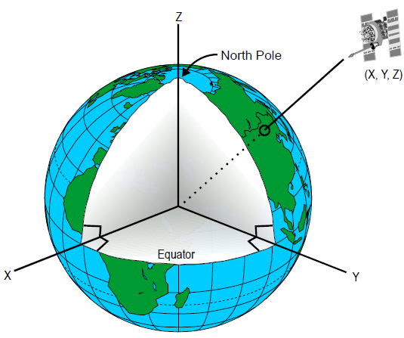
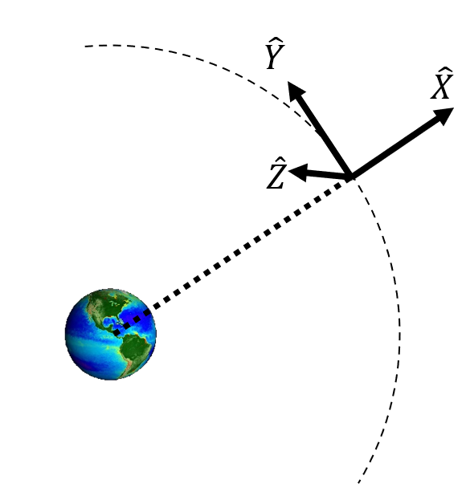
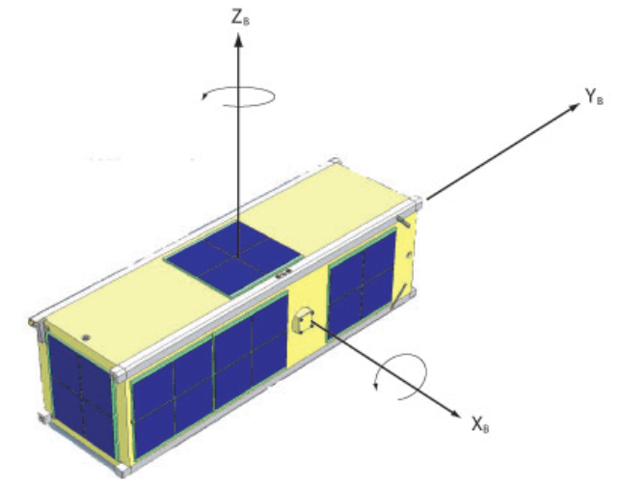
Review: Frames of reference
Radial In-track Cross-track (RIC)
A.K.A.
Local Vertical Local Horizontal (LVLH)
A.K.A
Radial Transverse Normal (RTN)
A.K.A
Etc…
Earth-Centered
Inertial (ECI)
Earth-Centered
Earth-Fixed (ECEF)
Spacecraft Body Frame

Slide 6
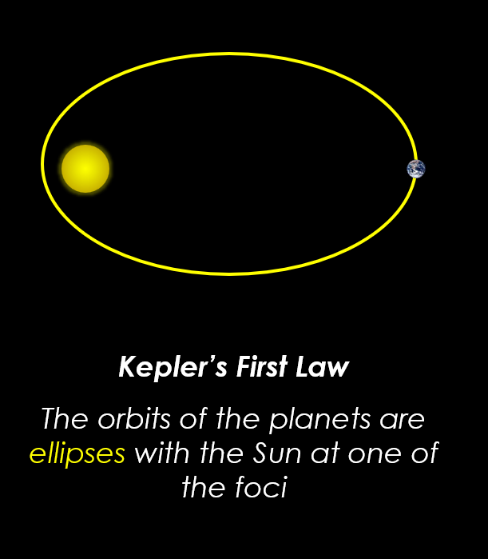
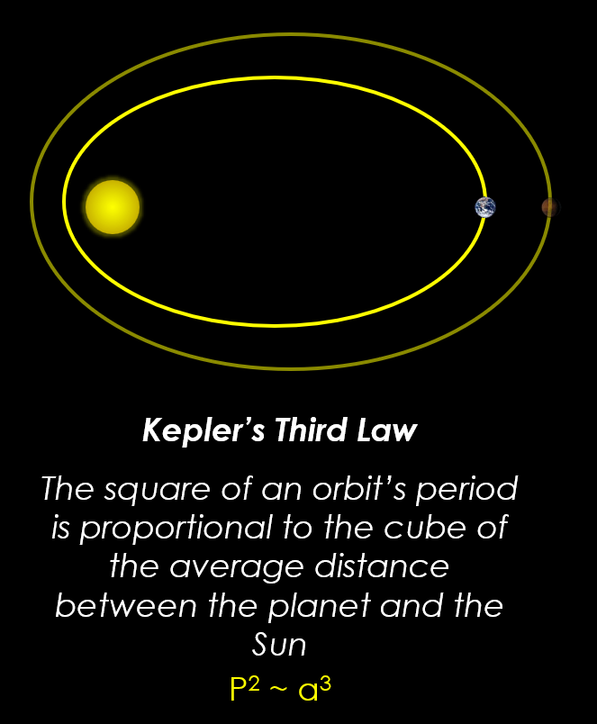
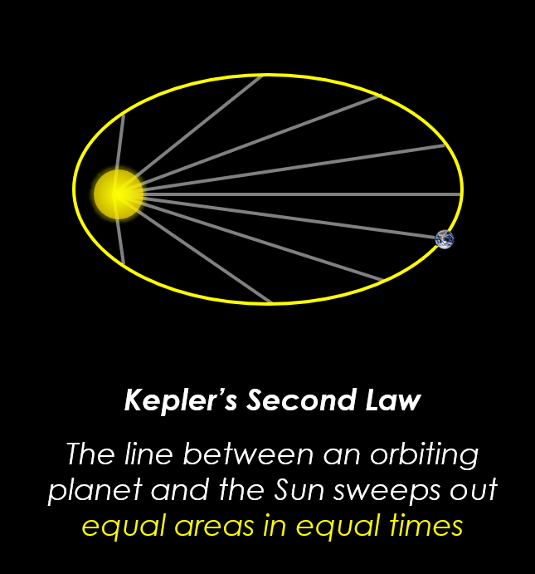
Review: Kepler’s Laws of Motion
40 days
40 days

Slide 7
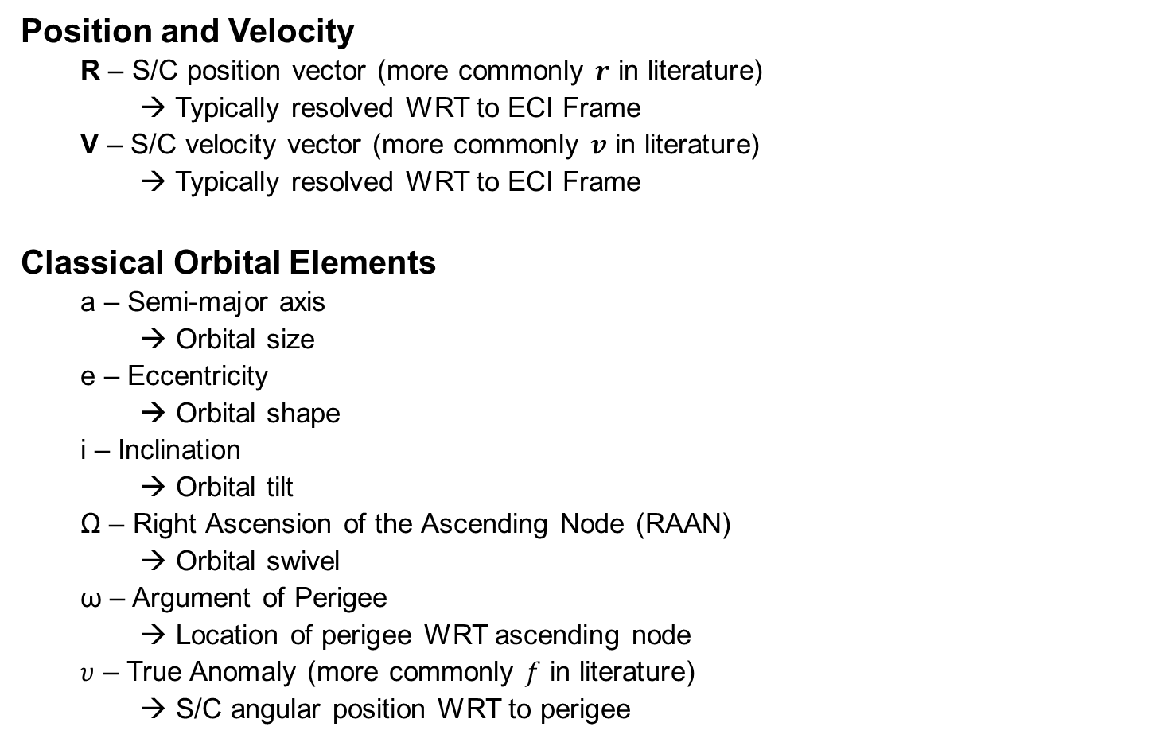
Review: Orbit Parameterization
Position and Velocity
R – S/C position vector (more commonly $r$ in literature)
→ Typically resolved WRT to ECI Frame
V – S/C velocity vector (more commonly $v$ in literature)
→ Typically resolved WRT to ECI Frame
Classical Orbital Elements
a – Semi-major axis
→ Orbital size
e – Eccentricity
→ Orbital shape
i – Inclination
→ Orbital tilt
Ω – Right Ascension of the Ascending Node (RAAN)
→ Orbital swivel
ω – Argument of Perigee
→ Location of perigee WRT ascending node
$υ$ – True Anomaly (more commonly $f$ in literature)
→ S/C angular position WRT to perigee

Slide 8
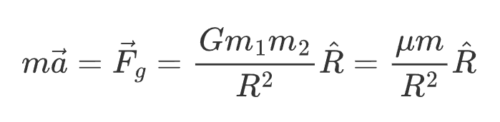
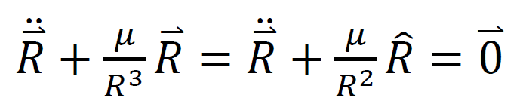
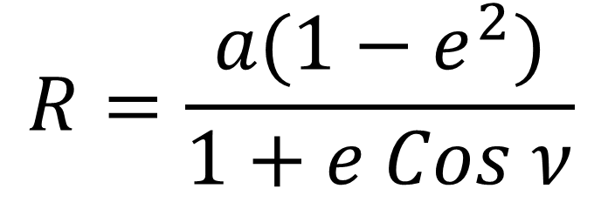
Review: 2BEOM
Two-body motion:
Astro 310 nomenclature:
second-order, nonlinear, autonomous ODE
$$R=\frac{a(1−e^{2})}{1+e Cos ν}$$
Closed-form solution:
Notes:
1. Problem Definition: R2BEOM
The restricted two-body problem assumes:
Two bodies interact only via Newtonian gravity
One body has negligible mass (spacecraft)
The central body is spherically symmetric
No perturbations (drag, J2, SRP, third bodies, thrust)
The equation of motion is
$$\ddot{r}=−μ\frac{r}{r^{3}}$$
where $r∈ℝ^{3}$is the position vector and $μ=GM$is the gravitational parameter of the central body.
This is a second-order, nonlinear, autonomous ODE, but it is fully integrable.
2. Why a Closed-Form Solution Exists
The R2BEOM admits a closed-form solution because:
Central force field → angular momentum is conserved
Time-invariant potential → mechanical energy is conserved
The force is inverse-square, which leads to conic-section trajectories
As a result, the motion reduces to a planar problem, and the trajectory is a conic section (ellipse, parabola, or hyperbola).
3. First Integrals of Motion
Angular Momentum
$$h=r×\dot{r}, \dot{h}=0$$
This fixes the orbital plane.
Specific Mechanical Energy
$$ℰ=\frac{v^{2}}{2}−\frac{μ}{r}$$
$ℰ<0$: ellipse
$ℰ=0$: parabola
$ℰ>0$: hyperbola
Eccentricity Vector
$$e=\frac{1}{μ}\left(\dot{r}×h\right)−\frac{r}{r}$$
Magnitude $e=∥e∥$determines orbit shape
Direction points toward periapsis
4. Closed-Form Spatial Solution (Orbit Geometry)
The trajectory equation in polar coordinates is
$$r\left(ν\right)=\frac{p}{1+e\cos{ν}}$$
where
$ν$= true anomaly
$p=\frac{h^{2}}{μ}$= semi-latus rectum
$e$= eccentricity
This is an exact, closed-form solution in space, independent of time.
5. Time Parameterization (Kepler’s Equation)
The remaining challenge is relating time to position.
Elliptic Orbits ($0≤e<1$)
Introduce eccentric anomaly $E$:
$$r=a\left(1−e\cos{E}\right)$$
$$M=E−e\sin{E}$$
$$M=n\left(t−t_{0}\right), n=\sqrt{\frac{μ}{a^{3}}}$$
This transcendental equation (Kepler’s Equation) must be solved numerically, but:
The formulation itself is closed-form
Only a scalar root-solve is required
Hyperbolic Orbits ($e>1$)
Using hyperbolic anomaly $H$:
$$r=a\left(e\cosh{H}−1\right)$$
$$M=e\sinh{H}−H$$
Parabolic Orbits ($e=1$)
Using Barker’s Equation:
$$t−t_{p}=\sqrt{\frac{p^{3}}{2μ}}\left(D+\frac{D^{3}}{3}\right)$$
where
6. State Vector Closed-Form Solution
Given an initial state $\left(r_{0} , v_{0}\right)$:
Compute orbital elements $\left(a , e , i , Ω , ω , M_{0}\right)$
Propagate mean anomaly:
$$M\left(t\right)=M_{0}+n\left(t−t_{0}\right)$$
Solve Kepler’s equation
Recover $ν\left(t\right)$
Compute $r\left(t\right)$, $v\left(t\right)$analytically
This yields an exact state transition, often written as
$$x\left(t\right)=f_{\text{Kepler}}\left(x_{0} , t\right)$$
7. Relationship to the State Transition Matrix (STM)
Although the state solution is closed-form, the STM is also analytically derivable (via Lagrange coefficients):
$$r\left(t\right)=fr_{0}+gv_{0}$$
$$v\left(t\right)=\dot{f}r_{0}+\dot{g}v_{0}$$
where $f,g,\dot{f},\dot{g}$are exact scalar functions of time and orbital elements.
This is why R2BEOM is foundational for:
Lambert solvers
Orbit determination
EKF / UKF linearization baselines
Relative motion derivations
8. Key Limitations of the Closed-Form Solution
The closed-form solution fails immediately when:
Non-central forces exist (J2, drag, thrust)
Central body is non-spherical
Third-body gravity is included
Time-varying $μ$or thrust acceleration is present
In those cases, numerical integration or perturbation theory is required.
9. Why R2BEOM Matters Pedagogically
The R2BEOM is unique because it is:
Nonlinear
Yet exactly integrable
With explicit constants of motion
And analytic time propagation
This makes it the benchmark model against which all real-world orbital dynamics are measured.
Summary Statement
The restricted two-body equations of motion admit a complete closed-form solution because the inverse-square gravitational force yields conserved energy, angular momentum, and eccentricity, reducing the dynamics to conic-section motion with analytically expressible time evolution via Kepler’s equation.

Slide 9
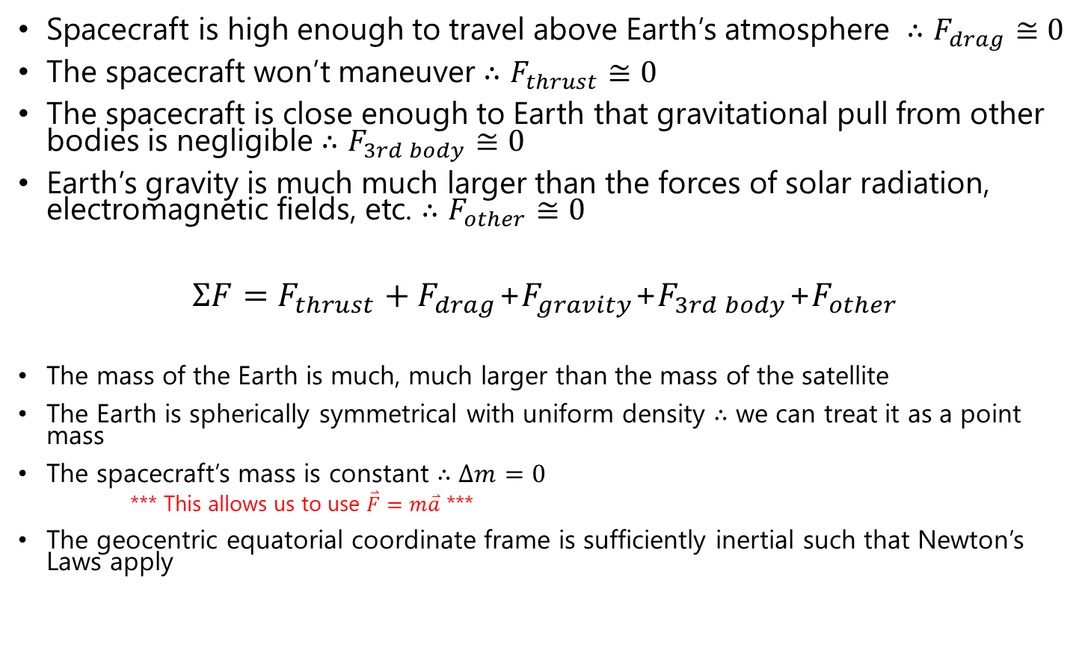
Review: R2BEOM Assumptions
Spacecraft is high enough to travel above Earth’s atmosphere $∴F_{drag}≅0$
The spacecraft won’t maneuver $∴F_{thrust}≅0$
The spacecraft is close enough to Earth that gravitational pull from other bodies is negligible $∴F_{3rd body}≅0$
Earth’s gravity is much much larger than the forces of solar radiation, electromagnetic fields, etc. $∴F_{other}≅0$
$ΣF=F_{thrust}+F_{drag}$+$F_{gravity}$+$F_{3rd body}$+$F_{other}$
The mass of the Earth is much, much larger than the mass of the satellite
The Earth is spherically symmetrical with uniform density $∴$ we can treat it as a point mass
The spacecraft’s mass is constant $∴$ $Δm=0$
*** This allows us to use $\overset{⃑}{F}=m\overset{⃑}{a}$ ***
The geocentric equatorial coordinate frame is sufficiently inertial such that Newton’s Laws apply
0
0
0
0

Slide 10
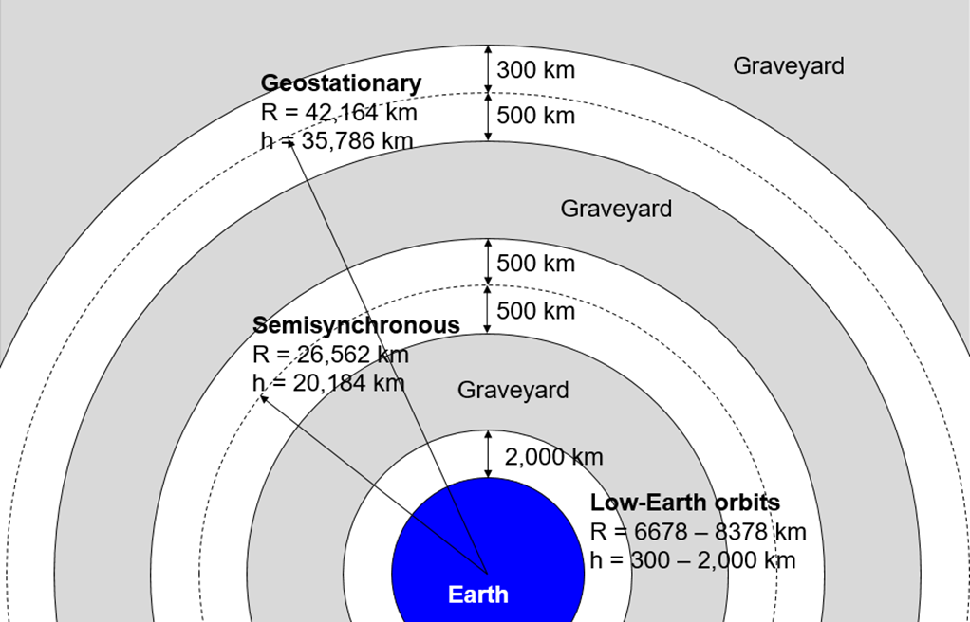
Review: Common Orbits
Attribute | LEO | MEO | GEO
Altitude | 300–2,000 km | ~26,562 km | 35,786 km
Orbital Period | 90 min – 2 hrs | ~12 hrs | 24 hrs (geostationary)
Signal Round Trip Time | ~0.01–0.05 sec | ~0.15 sec | ~0.24 sec
Uses | Earth observation, ISS, imaging, some comms | Navigation (GPS, Galileo), some comms | Weather, TV broadcasting, long-range comms
Advantages | Low latency, low cost, easier access | Balanced coverage & latency | Wide coverage, fixed position over Earth
Disadvantages | Small coverage, short dwell time, more satellites needed | Radiation exposure (Van Allen belts), higher cost than LEO | High latency, expensive, not ideal for polar regions
Notes:
There are different orbits needed at different times during mission lifetime​
Parking orbit: safe & convenient temporary orbit for S/C checkout​
Transfer orbit​
Operational orbit​
earth-based: coverage of Earth’s surface or near-Earth space (ex GEO, LEO. etc)​
space-referenced: principal characteristic is a specific location in space (ex Lagrange points)​
Disposal orbit

Slide 11

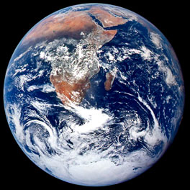

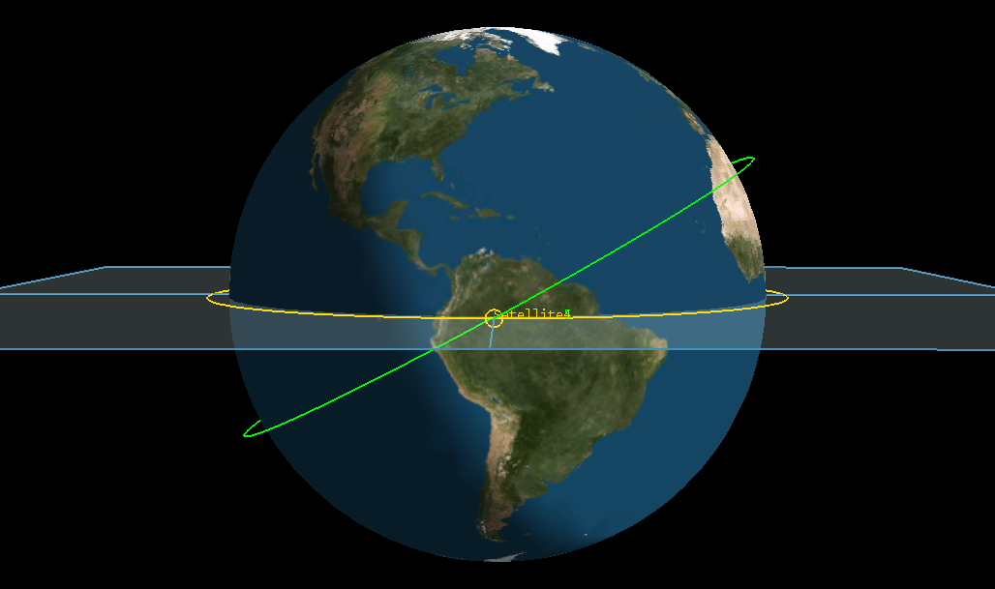
Review: Orbital Maneuvers
Hohmann Transfer
Co-orbital Rendezvous
2
2
Plane Change

Slide 12
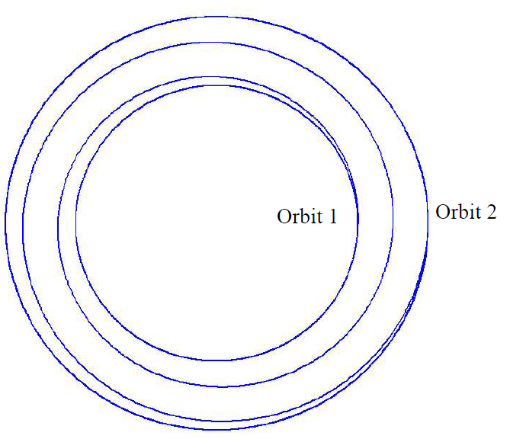

Orbital Maneuvers: Low Thrust Spiral

Slide 13
Perturbations
A disturbance to the motion of an orbiting body that causes its orbital parameters to vary over time from the idealized Keplerian motion.
Drag
→ Changes orbit size and shape (a & e)
J2
→ Changes RAAN
Ex orbit: Sun Synchronous (~98 deg)
→ Changes Argument of Perigee
Ex orbit: Molnyia (63.4 deg)
Others:
3rd Body gravity (moon, sun)
Solar radiation pressure
Tides

Slide 14
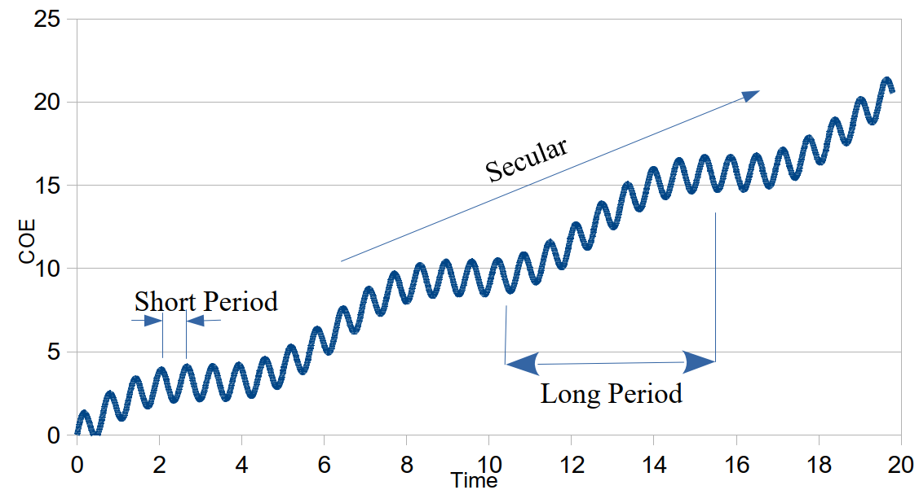
Perturbations: Types of Variations
Short Periodic – variations shorter than 1 orbital period
Long Periodic – variations longer than 1 orbital period
Secular – non-periodic variations

Slide 15
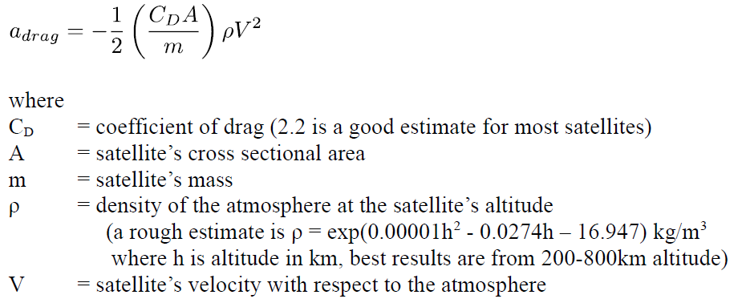

Drag
Drag continually removes energy from orbits, causing them to decrease in size.
Acceleration due to drag:
Ballistic Coefficient:
← Higher BC means drag affects sat less
Notes:
In the drag equation, the density term is the hardest term to compute because it has several things that
drive its value:
• Diurnal Variations (day/night)
• 27-day solar rotation cycle
• 11-year Sun spot cycles
• Semi-annual variations (Sun latitude and distance)
• Rotating Atmosphere
• Winds
• Magnetic- storms
• Tides
• Others…

Slide 16
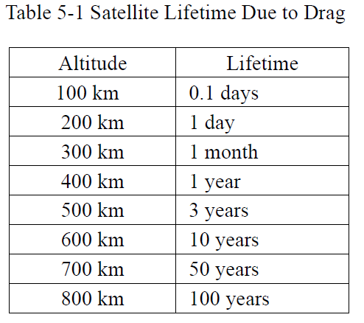
Drag (cont.)

Slide 17
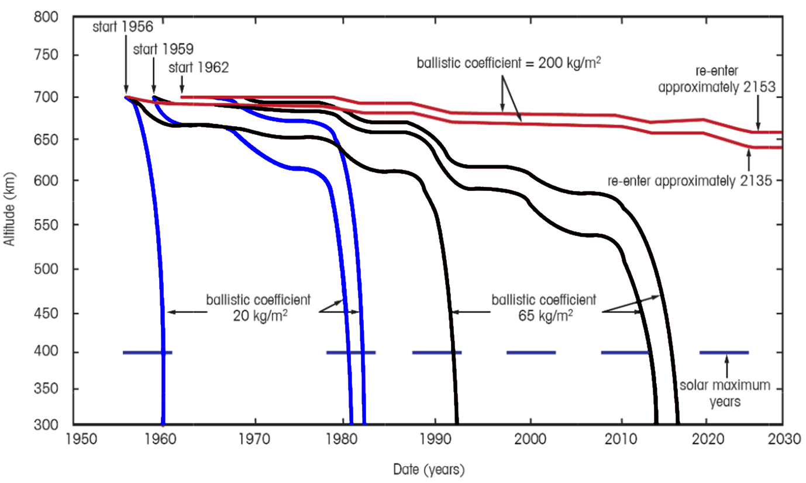
Drag: Effect of Ballistic Coefficient

Slide 18
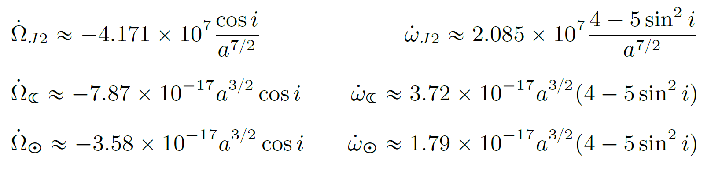
J2 & 3rd Body Effects
Notes:
Angular rates in rad/s, distances in km
Dahlke text has different 3rd body equations that depend on mean motion.

Slide 19
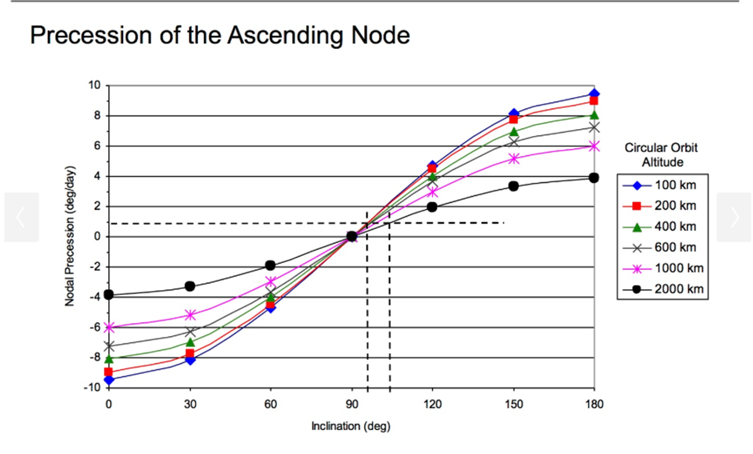
J2 Effect of RAAN

Slide 20
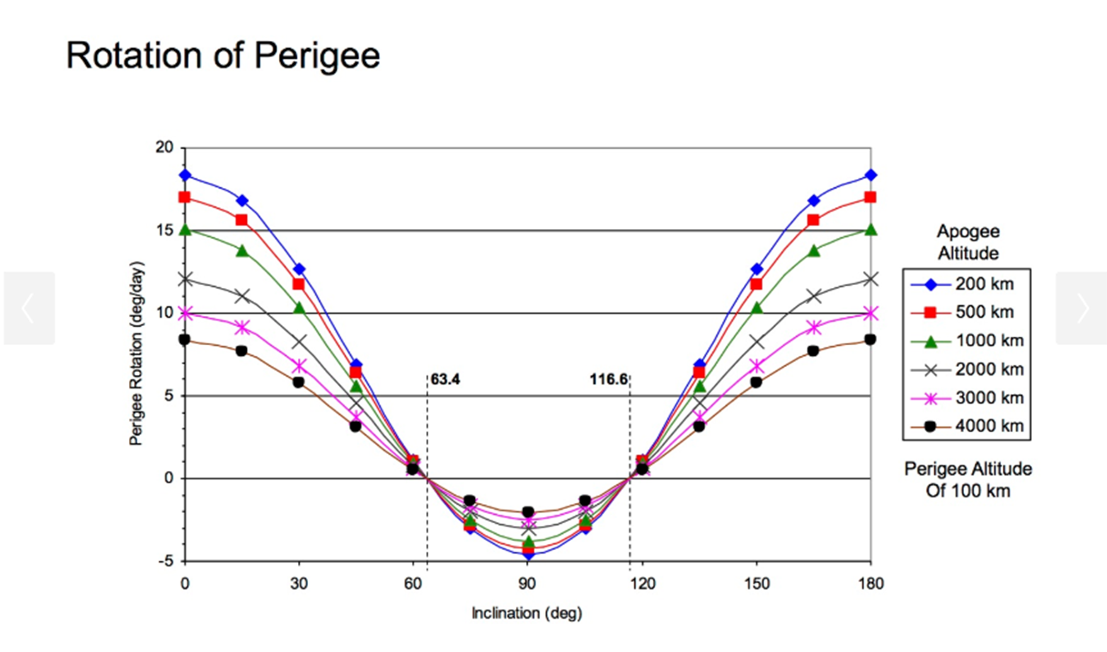
J2 Effect of Argument of Perigee

Slide 21
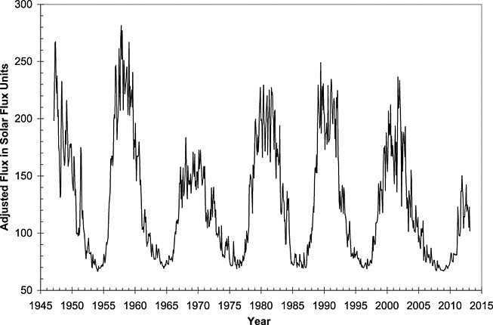
Solar Radiation Pressure
Solar Cycles:

Slide 22
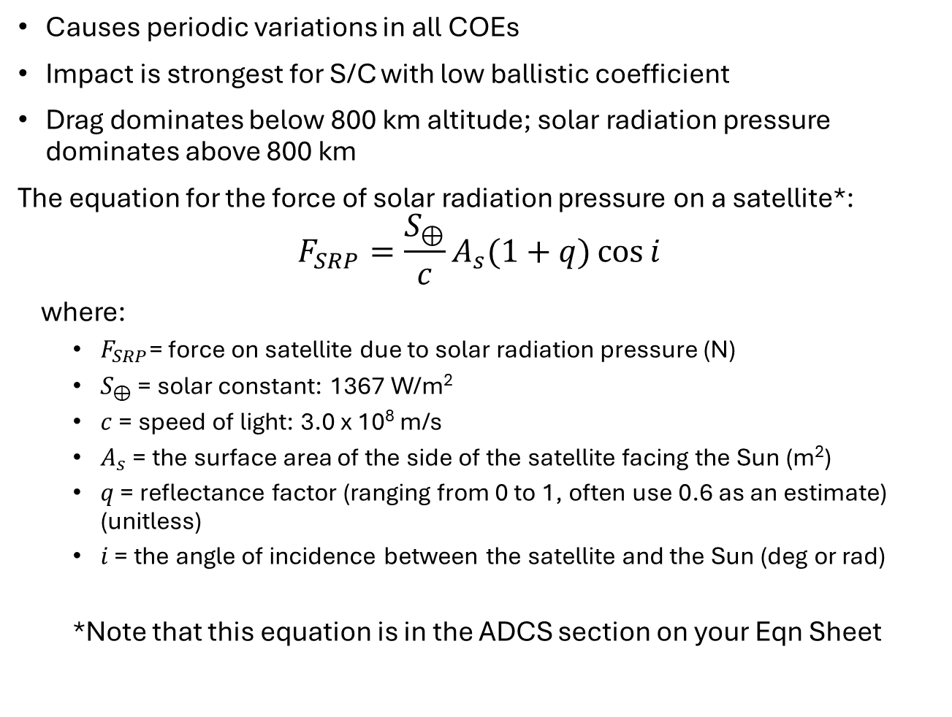
Solar Radiation Pressure (SRP) Effects
Causes periodic variations in all COEs
Impact is strongest for S/C with low ballistic coefficient
Drag dominates below 800 km altitude; solar radiation pressure dominates above 800 km
The equation for the force of solar radiation pressure on a satellite*:
$$F_{SRP}=\frac{S_{⊕}}{c}A_{s}(1+q)\cos{i}$$
where:
$F_{SRP}$= force on satellite due to solar radiation pressure (N)
$S_{⊕}$ = solar constant: 1367 W/m²
$c$ = speed of light: 3.0 x 10⁸ m/s
$A_{s}$ = the surface area of the side of the satellite facing the Sun (m²)
$q$ = reflectance factor (ranging from 0 to 1, often use 0.6 as an estimate) (unitless)
$i$ = the angle of incidence between the satellite and the Sun (deg or rad)
*Note that this equation is in the ADCS section on your Eqn Sheet

Slide 23
Mission Geometry

Slide 24
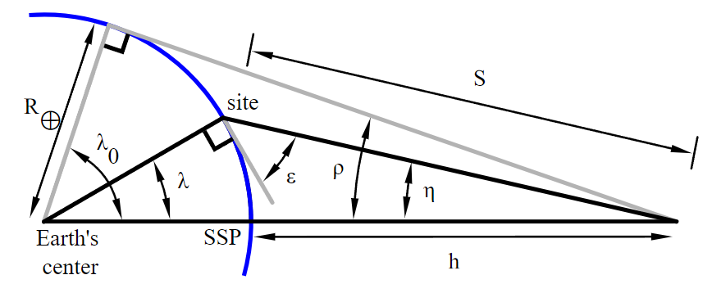
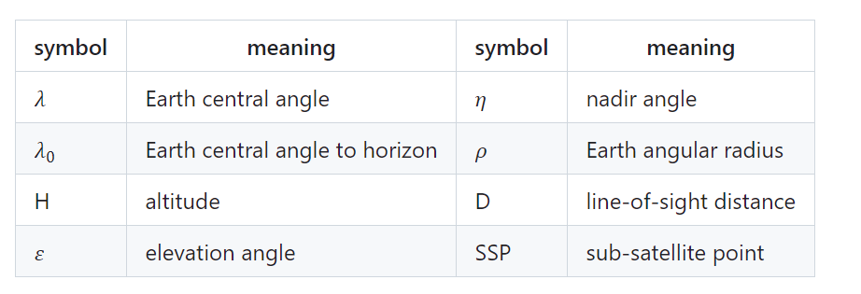
Mission Geometry
h
S

Slide 25
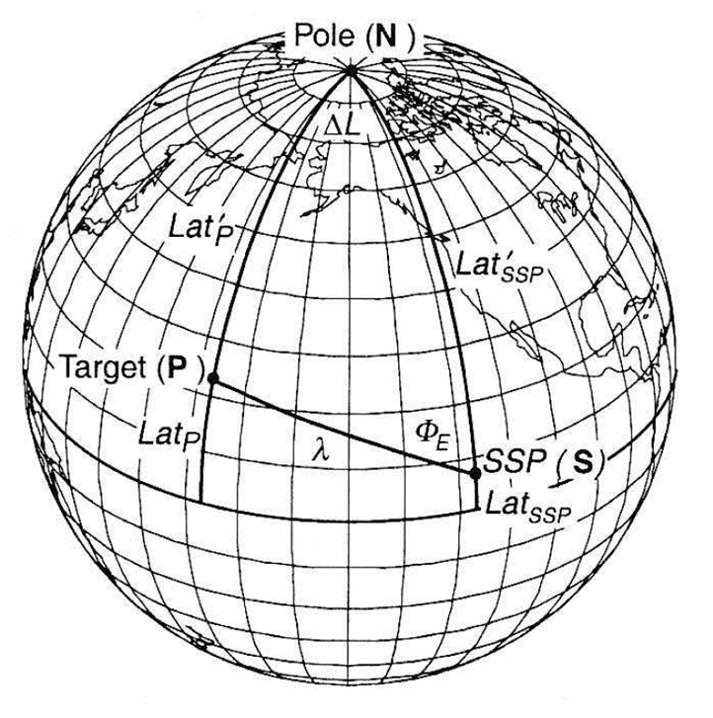
Mission Geometry (cont.)

Slide 26
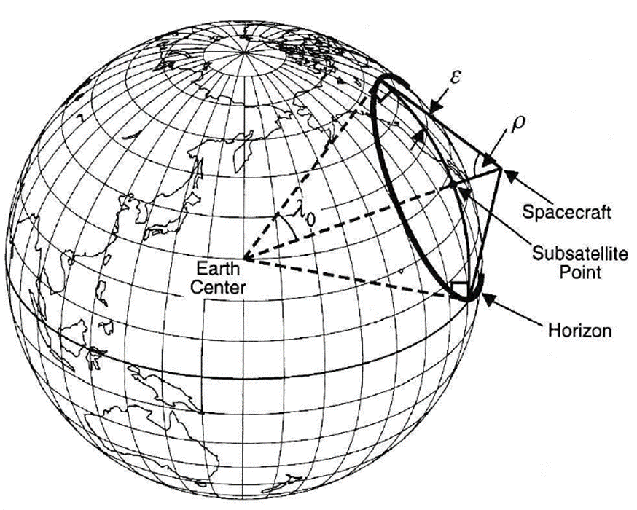
Mission Geometry (cont.)

Slide 27
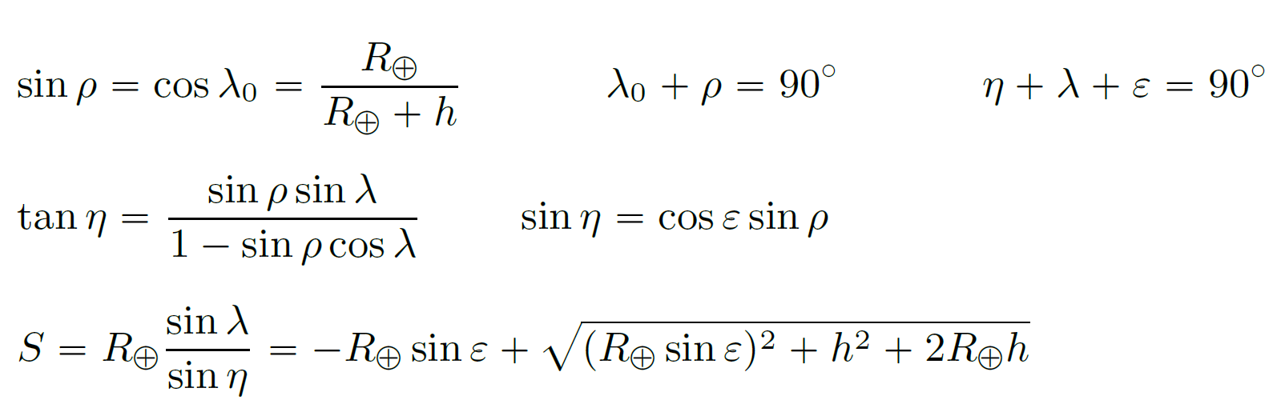
Mission Geometry (cont.)

Slide 28
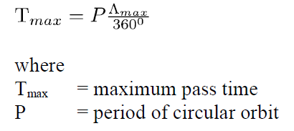

Pass Time
If a ground station is at a lower latitude than the inclination of a satellite in a circular orbit, the maximum pass time (i.e. the time s/c is in view of ground station) can be estimated as:
Rules of Thumb:
Average Pass = 80% of Tmax
86% of passes will be longer than Tmax/2

Slide 29
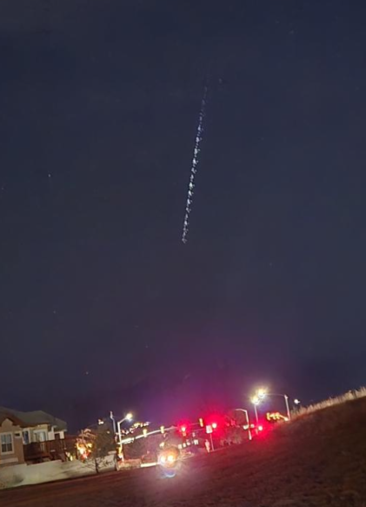
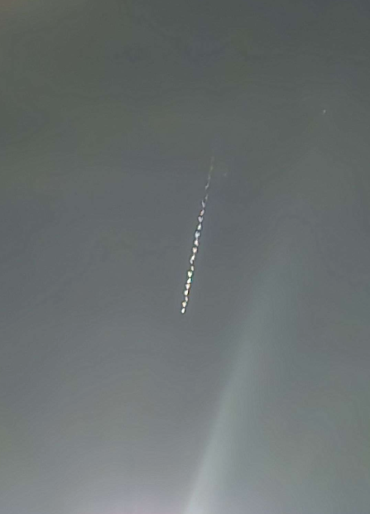
What is this?

Slide 30
Constellation Design

Slide 31
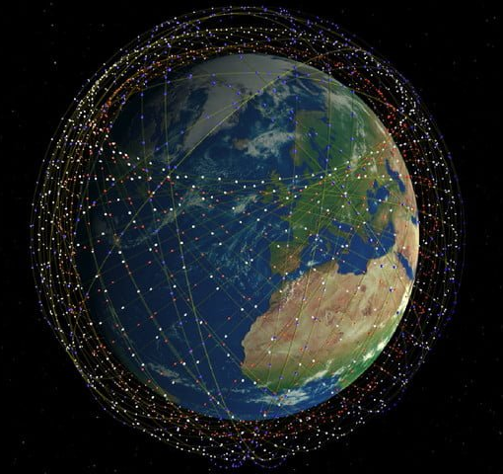
What Is a Satellite Constellation?
A coordinated set of satellites whose collective behavior delivers a service that a single satellite cannot provide reliably or continuously.
Typical mission drivers:
Global or regional coverage
Persistence (revisit time)
Redundancy and resilience
Latency reduction
Capacity scaling

Slide 32
Constellation Considerations
Coverage depends on:
Altitude
Sensor or antenna field of view
Minimum elevation angle
Earth rotation
Constellation design is not just orbital mechanics.
Ground station network
Inter-satellite links (ISL)
Data routing and latency
Command and control capacity
For example:
LEO constellations often require ISLs to reduce ground latency
GEO systems rely heavily on ground infrastructure

Slide 33
Common Constellations
Constellation | Altitude | Inclination | # Satellites for Global Coverage | Main Use
Walker Delta | LEO/MEO | Any | 18–30+ | GNSS, EO
Polar | LEO | 90° | 8–12 | EO, weather
Sun-Synchronous | LEO | ~98° | 8–12 | Imaging
Molniya | HEO | ~63.4° | 3–4 | Comm at high latitudes
GEO | GEO | 0° | 3–4 | Comm, weather
Mega-Constellation | LEO/MEO | Varies | 100s–1000s | Broadband, EO
Notes:
1. Walker Delta (Walker Constellations)
Structure: Satellites arranged evenly in multiple orbital planes with equal inclination.
Parameters: Defined by the Walker notation i: t/p/f
i = inclination
t = total satellites
p = number of orbital planes
f = phasing factor
Uses: GNSS (GPS, Galileo), some Earth observation systems.
Example: Galileo (24 satellites, 3 planes, 56° inclination).
Advantages: Uniform global coverage, predictable geometry.
2. Polar Constellations
Structure: Orbits pass over or near both poles (90° inclination).
Coverage: Global coverage as Earth rotates beneath the satellites.
Uses: Earth observation, weather monitoring, reconnaissance.
Example: NOAA POES satellites, RADARSAT.
Advantages: Full Earth coverage with fewer satellites than equatorial orbits.
3. Sun-Synchronous Constellations
Structure: Special polar orbit where the orbital plane precesses at the same rate the Earth orbits the Sun.
Benefit: Passes over each point on Earth at the same local solar time → consistent lighting for imaging.
Uses: Imaging, mapping, climate monitoring.
Example: Landsat, Sentinel-2.
Advantages: Lighting consistency for long-term data comparison.
4. Molniya Constellations
Structure: Highly elliptical orbits (HEO) with apogee over high latitudes.
Coverage: Long dwell time over northern regions; suited for countries at high latitudes.
Uses: Communications for high-latitude countries.
Example: Russian Molniya network.
Advantages: Better coverage for polar regions than GEO satellites.
5. Geostationary (GEO) Constellations
Structure: Satellites placed in equatorial circular orbit at ~35,786 km altitude, matching Earth’s rotation.
Coverage: Fixed coverage over one hemisphere.
Uses: Communications, weather monitoring.
Example: GOES weather satellites, Inmarsat.
Advantages: Continuous coverage of a region, no ground antenna tracking needed.
6. Mega-Constellations
Structure: Hundreds or thousands of satellites in LEO or MEO.
Uses: Broadband internet, high-frequency Earth observation.
Example: Starlink, OneWeb, Kuiper.
Advantages: Low latency, high capacity, global reach.

Slide 34
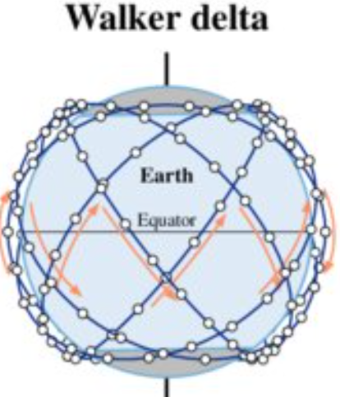
Walker Delta Constellation
Structure: Satellites arranged evenly in multiple orbital planes with equal inclination.
Parameters: Defined by the Walker notation
I: T/P/F
I = inclination
T = total satellites
P = number of orbital planes
F = phasing factor
Uses: GNSS (GPS, Galileo), some Earth observation systems.
Example: Galileo (24 satellites, 3 planes, 56° inclination).
Advantages: Uniform global coverage, predictable geometry.
Example: Starlink Phase 1
53°:1,584/22/17
Notes:
The F Parameter in a Walker Δ (Delta) Constellation
In a Walker Delta constellation, F defines how satellites in adjacent orbital planes are shifted along their orbits to evenly distribute access in time and minimize revisit gaps.
1. Walker Δ Notation Refresher
A Walker Delta constellation is written as:
$$T/P/F$$
Where:
$T$= total number of satellites
$P$= number of equally spaced orbital planes
$F$= relative phasing parameter
Each plane contains:
$$S=\frac{T}{P} \text{satellites} \text{per} \text{plane}$$
2. What F Physically Represents
F is an integer that sets the along-track offset between satellites in neighboring planes.
Specifically:
When moving from plane $k$ to plane $k+1$, the satellites are shifted forward in true anomaly (or mean anomaly) by:
$$Δν=\frac{{360}^{∘}}{T} F$$
This shift is applied cumulatively across planes.
3. Why Phasing Matters
Without proper phasing:
Satellites in different planes pass over the same longitude at nearly the same time
This creates coverage gaps, clustering, or redundant passes
With proper F:
Satellites are evenly interleaved in time
Ground tracks are uniformly distributed
Revisit time is minimized
In other words:
F controls temporal spacing, not spatial spacing.
4. Interpretation Through Extremes
Case 1: F = 0
All planes are aligned in phase
Satellites in different planes cross the equator at nearly the same longitude and time
Worst-case revisit performance
Case 2: F = 1
Each adjacent plane is offset by one satellite spacing
Produces uniform temporal coverage
Very common choice
Case 3: F = P − 1
Maximum relative shift before symmetry repeats
Often equivalent (by symmetry) to a smaller F value
5. Constraint on F
Because the constellation is symmetric:
$$0≤F≤P−1$$
Larger values simply repeat earlier patterns.
6. Engineering Meaning
A helpful analogy:
Think of each orbital plane as a lane on a circular track
Satellites in one lane are evenly spaced
F tells you how far you rotate the starting position of each lane relative to the previous one
7. Why Walker Δ Uses an Integer F
Using integer phasing:
Preserves symmetry
Simplifies operations and station-keeping
Produces repeatable ground tracks
This is why Walker constellations are easy to scale and analyze.

Slide 35
Resilience and Threat Considerations
Modern constellation design must account for:
Single-satellite loss
Orbital debris
Jamming or interference
Kinetic and non-kinetic threats
This drives trends toward:
Proliferated LEO
Smaller satellites
Rapid replenishment
Disaggregation of payloads

Slide 36
Example

Slide 37
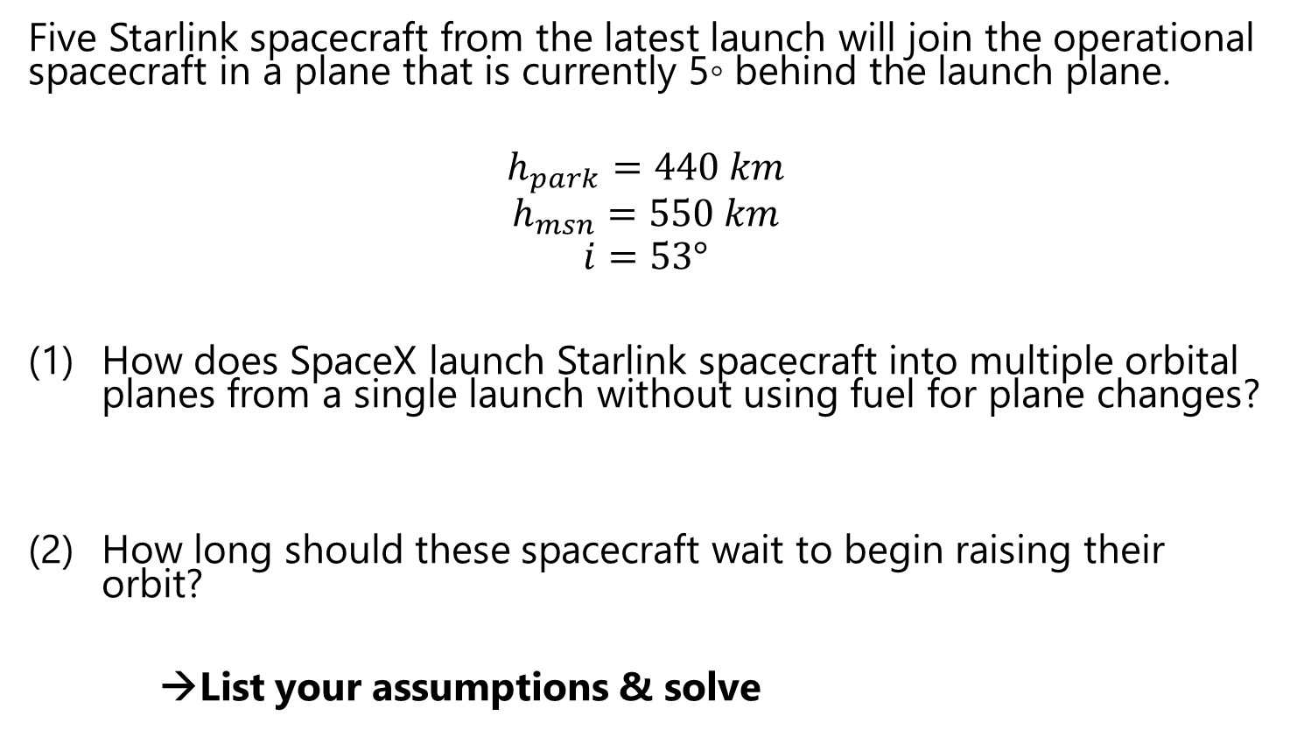
Example Problem
Five Starlink spacecraft from the latest launch will join the operational spacecraft in a plane that is currently 5◦ behind the launch plane.
$$h_{park}=440 km$$
$$h_{msn}=550 km$$
$$i=53°$$
How does SpaceX launch Starlink spacecraft into multiple orbital planes from a single launch without using fuel for plane changes?
How long should these spacecraft wait to begin raising their orbit?
→List your assumptions & solve

Slide 38
EXTRA MATERIAL

Slide 39
Constellation Design Steps
(Taken from previous semester slides)

Slide 40
Step 1: Establish Orbit Types
There are different orbits needed at different times during mission lifetime
Parking orbit: safe & convenient temporary orbit for S/C checkout
Transfer orbit
Operational orbit
earth-based: coverage of Earth’s surface or near-Earth space (ex GEO, LEO. etc)
space-referenced: principal characteristic is a specific location in space (ex Lagrange points)
Disposal orbit

Slide 41
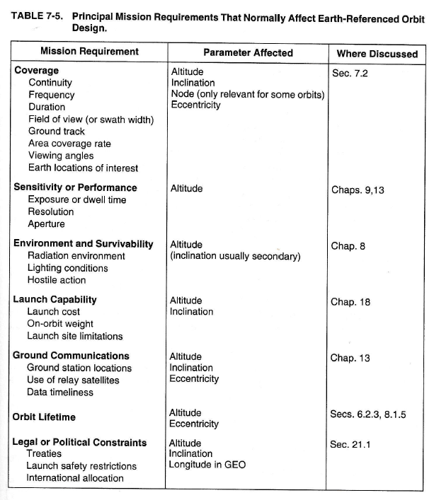
Step 2: Determine Orbit-Related Mission Reqts

Slide 42
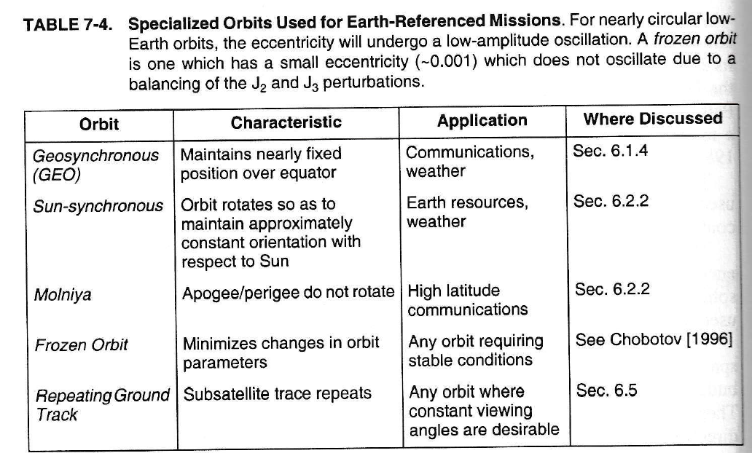
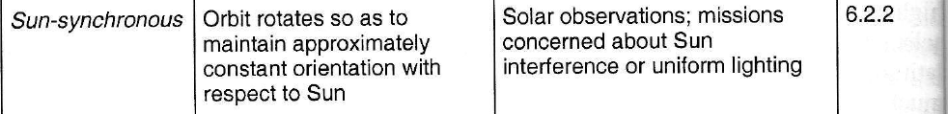
Step 3: Assess Standard Orbits
From Table 7-8

Slide 43
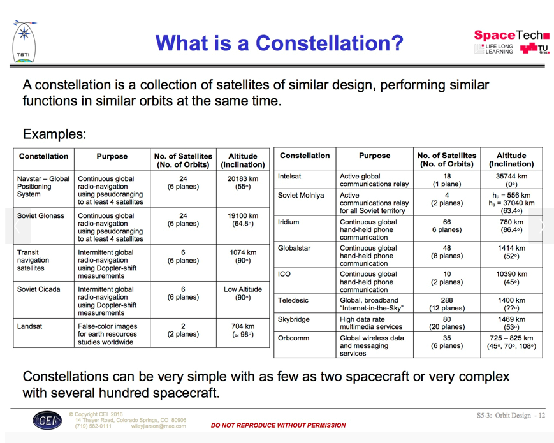
Designing Space Missions and Systems, Presentation Slide S5-3: Orbit Design - 12

Slide 44
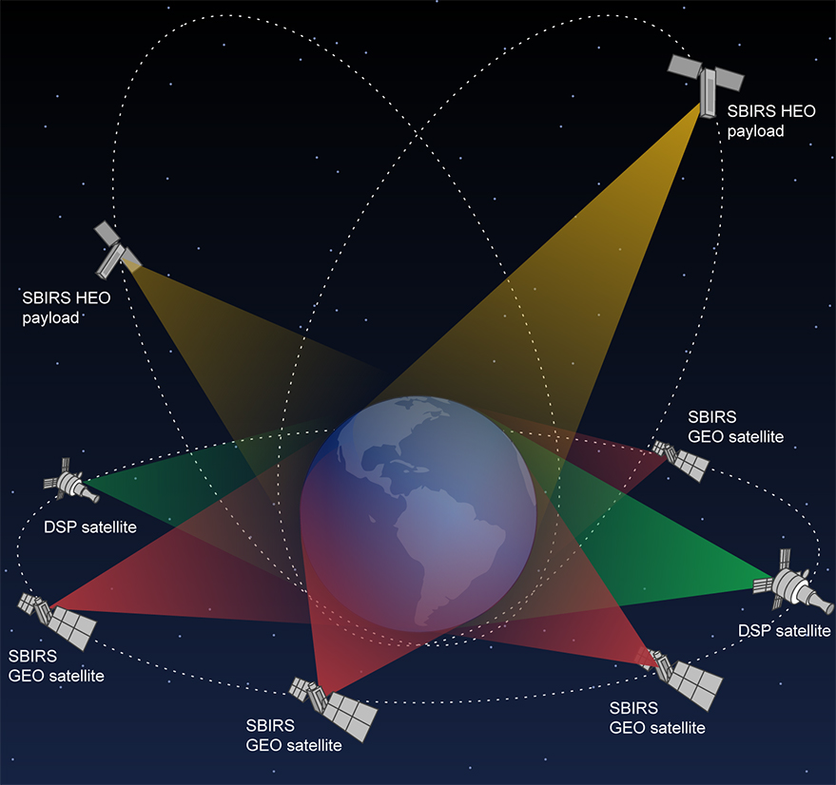
Notes:
SBIRS constellation

Slide 45

Notes:
Starlink constellation

Slide 46
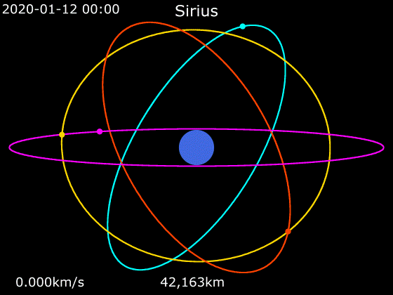
Notes:
Sirius XM radio

Slide 47
Step 4: Single Satellite vs Constellation
key trade is usually single, large S/C w/complex instruments vs constellation of smaller, simpler S/C
single S/C reduces cost by minimizing mission overhead
constellations provide
better temporal or spatial coverage
more robust comm links
on-orbit spares offer higher system reliability if a S/C is lost
more survivability
multiple environmental conditions or geometries to carry out mission
Consider principal factors in designing a constellation (Table 7-10)

Slide 48
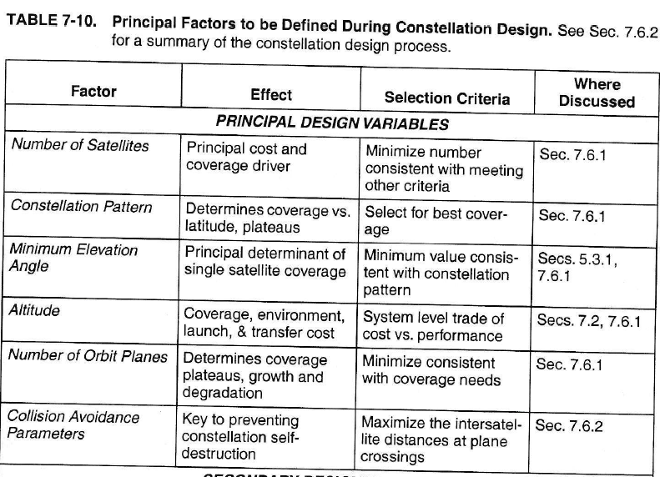
Principal Factors to Consider

Slide 49
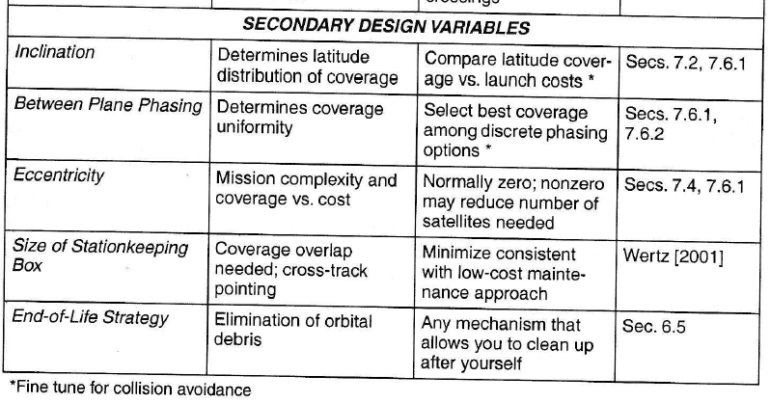
Constellation options
Walker Delta
Two-Plane Polar
Three mutually perpendicular planes
Two perpendicular non-polar planes
Five-plane polar “streets of coverage”

Slide 50
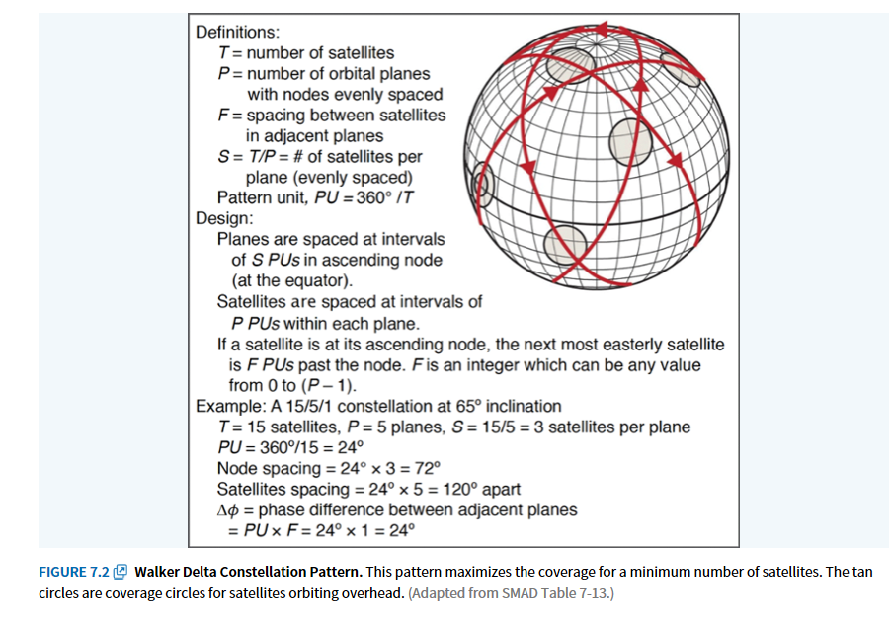
Walker Delta Constellation

Slide 51
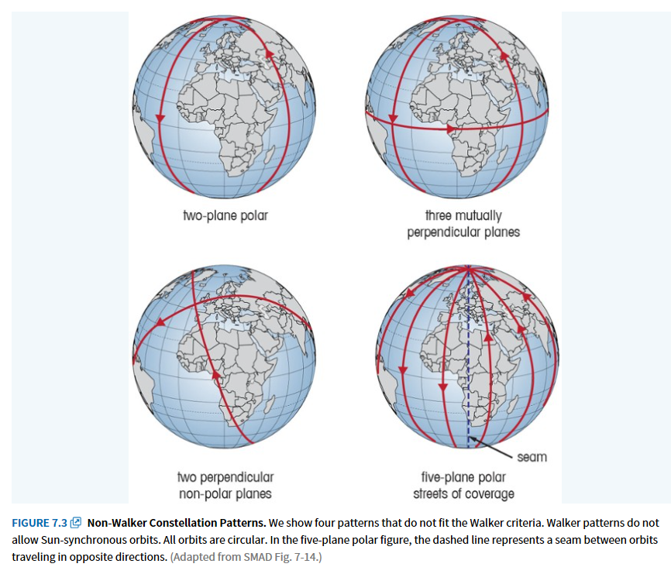
Fig 7-14 in SMAD

Slide 52
Step 5: Perform Mission Design Trades
Footprint area (F_{A} or FOV area)
area that a specific instrument or antenna can see at any instant
Instantaneous access area (IAA)
all the area that an instrument or antenna could potentially see at any instant if it were scanned through its normal range of orientations
Area coverage rate (ACR)
the rate at which the instrument or antenna is sensing or accessing new land
Area access rate (AAR)
the rate at which new land is coming into the spacecraft’s access area

Slide 53
Coverage Figures of Merit
Percent coverage
# of times a point was covered by one or more satellites divided by the total number of simulation time steps
Maximum coverage gap
The longest coverage gap of an individual point
Mean coverage gap
Average length of breaks in coverage for a given point on a grid
Time average gap
Mean gap duration averaged over time
Mean response time
Average time from receipt of a request to observe a particular point until we can observe it

Slide 54
Constellation Design Issues
coverage (look at coverage (performance) vs number of S/C (cost))
maneuvers
avoid switching orbital planes
limit number of planes to limit number of launches
rephasing S/C w/in orbital plane uses very little propellant
number of orbit planes
#planes determines #times a given surface area can be accesses
#S/C in a plane determine gaps in coverage
plateaus and degradation
each additional S/C adds performance
graceful degradation means if one S/C fails, remaining S/C provide needed service at reduced level rather than total loss of service
use computer modeling to assess performance
launch vehicle selection
try to match #orbit planes and S/C in each plane to number of S/C that can be launched on one L/V
reasonable to begin constellation design assuming all S/C in circular orbits at same altitude and inclination

Slide 55
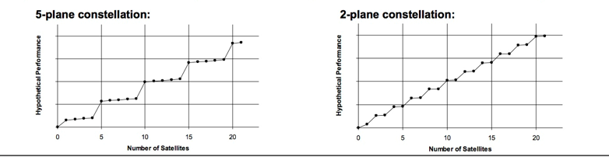
Performance Plateaus
Designing Space Missions and Systems, Presentation Slide S5-3: Orbit Design - 16

Slide 56
Step 6: Assess Orbital Transfer, Launch, and Retrieval/Disposal Options Step 7: Evaluate Constellation Growth and Satellite Replenishment
often requires numerical solns to evaluate coverage Figures of Merit
performance tends to come in plateaus (flip side is graceful degradation)
generally some performance benefit with first S/C
major performance plateau may not occur next until plane is populated or each plane has at least one S/C

Slide 57
Step 8: Create a ΔV Budget Step 9: Iterate & Document
Account for ΔVs needed
Think perturbations, station-keeping, momentum dumping, etc

Slide 58
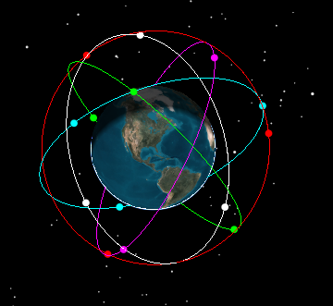
Example: Walker-Delta Constellation
Example: 15/5/2 Walker Delta Constellation
Given: COEs for 1st S/C:
a = X km
e = 0
i = Y deg
Ω = 10 deg
u = 0 deg
Find: COEs for remaining S/C in constellation

